Slide 1

BI Final
Farouq Hassan

Slide 2
Introduction to Business Intelligence (BI)
The term "business intelligence" (BI) describes the process of converting raw data into information that can be used for business analysis by employing techniques for data analysis.
Components:
- Data Collection
- Data Integration
- Data Analysis
- Reporting and Visualization

Slide 3
Importance of Business Intelligence
Enhances Decision-Making
Improves Operational Efficiency
Drives Competitive Advantage
Notes:
Importance of Business Intelligence
Enhances Decision-Making: Provides valuable insights for strategic decisions in real-time.
Improves Operational Efficiency: Streamlines processes and identifies inefficiencies.
Drives Competitive Advantage: Predicts market trends and adapts strategies accordingly.

Slide 4
Common BI Tools
Microsoft Power BI
Tableau
QlikView and Qlik Sense
SAP BusinessObjects
IBM Cognos Analytics
Notes:
Microsoft Power BI: Interactive visualizations and business intelligence capabilities.
Tableau**: Known for strong data visualization capabilities.
QlikView and Qlik Sense: Associative data indexing for uncovering insights.
SAP BusinessObjects: Comprehensive suite for reporting and analysis.
IBM Cognos Analytics: Reporting, dashboarding, and data exploration.

Slide 5
BI Techniques and Processes
Data Warehousing
Data Mining
ETL (Extract, Transform, Load
OLAP (Online Analytical Processing)
Data Visualization
Predictive Analytics
Notes:
Data Warehousing: Collecting, storing, and managing data in a central repository.
Data Mining: Discovering patterns and relationships in large datasets.
ETL (Extract, Transform, Load)**: Extracting data, transforming it, and loading it into a data warehouse.
OLAP (Online Analytical Processing): Analyzing multidimensional data from different perspectives.
Data Visualization: Creating graphical representations of data.
Predictive Analytics: Using historical data to make predictions about future events.

Slide 6

Power BI Overview
A powerful BI tool for creating interactive visualizations and reports.
Key Features:
- Data Integration
- Data Modeling
- DAX (Data Analysis Expressions)
- Interactive Dashboards

Slide 7
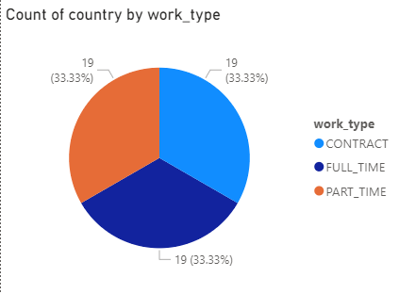
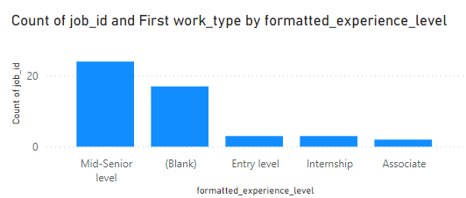
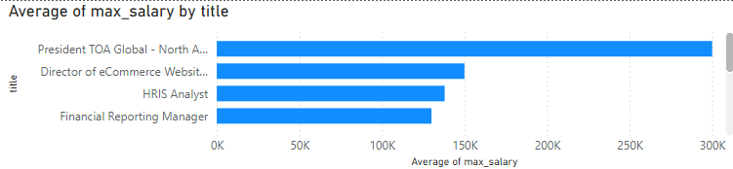
Example Visualizations
Pie Chart
Line and stacked column chart
Stacked Bar Chart

Slide 8
Overview of the Power BI Dashboard
This dashboard is designed to provide a comprehensive analysis of LinkedIn job postings. It includes various visualizations to help recruiters, job seekers, and strategic planners make informed decisions.

Slide 9
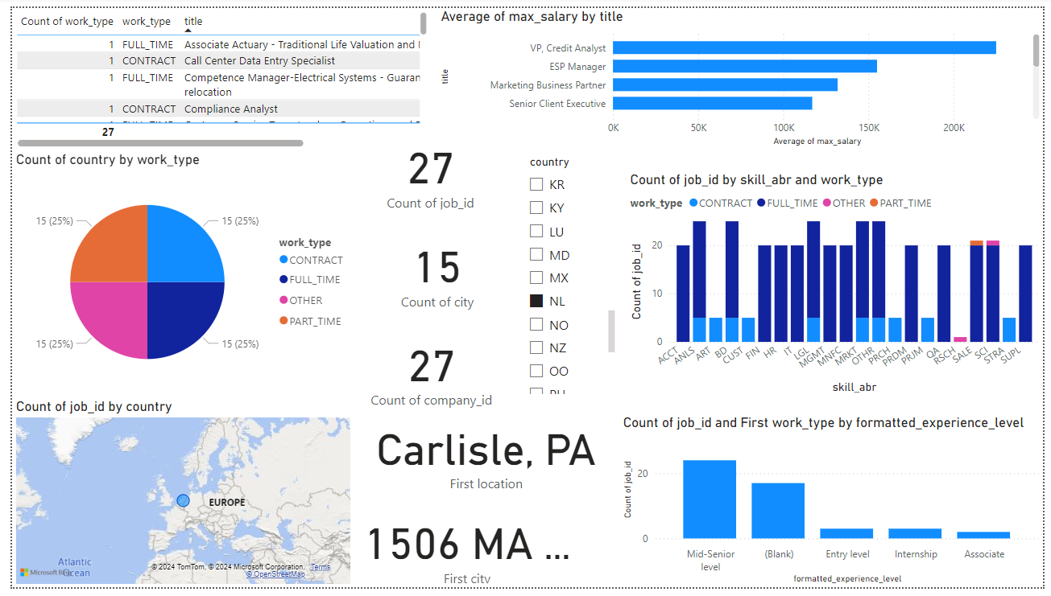

Slide 10
Key Visualizations:
Job Postings by Work Type (Pie Chart)
Average Maximum Salary by Title (Bar Chart)
Job IDs by Skill and Work Type (Stacked Bar Chart)
Geographical Distribution of Job Postings (Map Visualization)
Experience Level Analysis (Bar Chart)
Notes:
Key Visualizations:
Job Postings by Work Type (Pie Chart):
This pie chart shows the distribution of job postings across different work types such as Full-time, Part-time, and Contract.
Average Maximum Salary by Title (Bar Chart):
This bar chart compares the average maximum salaries for different job titles, providing insights into salary benchmarks.
Job IDs by Skill and Work Type (Stacked Bar Chart):
This stacked bar chart displays the count of job postings by skill and work type, highlighting the demand for various skills across employment types.
Geographical Distribution of Job Postings (Map Visualization):
This map shows the distribution of job postings across different countries, providing a geographical perspective of the job market.
Experience Level Analysis (Bar Chart):
This bar chart shows the distribution of job postings by experience level, helping to understand the demand for different experience levels.

Slide 11
Implementation Steps
Data Integration
Data Modeling
Visualization Creation
Dashboard Layout
Notes:
Data Integration: Importing and cleaning the LinkedIn job postings dataset.
Data Modeling: Creating relationships between tables and preparing data for analysis.
Visualization Creation: Designing and configuring each visualization in Power BI.
Dashboard Layout: Arranging the visualizations in a cohesive and user-friendly layout.

Slide 12
Benefits of the BI Tool
Comprehensive Analysis
Informed Decision-Making
Interactive Insights
Scalability
Notes:
Comprehensive Analysis: Provides a detailed view of job market trends.
Informed Decision-Making: Supports strategic decisions for recruiters and job seekers.
Interactive Insights: Allows users to interact with data and explore various aspects.
Scalability: Can be scaled to include more data sources and advanced analytics.

Slide 13
Importance of Decision-Making in Business:
Effective decision-making is crucial for the success and growth of any business.
In today’s competitive environment, businesses need to make informed decisions quickly to stay ahead.
Data-driven decision-making enables organizations to leverage data insights for strategic planning and operational efficiency.

Slide 14
How BI Tools Facilitate Decision-Making:
transforming raw data into actionable insights.
integrate data from various sources, perform complex analyses, and present the findings in intuitive visual formats.
help businesses make informed decisions based on current and comprehensive data.
Notes:
Business Intelligence (BI) tools like Power BI play a pivotal role in transforming raw data into actionable insights.
These tools integrate data from various sources, perform complex analyses, and present the findings in intuitive visual formats.
By providing real-time data visualization, BI tools help businesses make informed decisions based on current and comprehensive data.

Slide 15
The Role of BI Tools in Decision-Making
Data Gathering
Data Processing
Data Visualization
Real-Time Insights
Collaborative Decision-Making
Notes:
Data Gathering:
BI tools collect data from multiple sources such as databases, spreadsheets, and cloud services.
This aggregated data provides a holistic view of the business environment.
Data Processing:
BI tools process and clean the collected data to ensure accuracy and relevance.
They use data transformation techniques to prepare the data for analysis.
Data Analysis:
BI tools apply advanced analytical techniques, including statistical analysis, predictive modeling, and trend analysis.
They uncover patterns, correlations, and insights that are not immediately apparent.
Data Visualization:
BI tools present the analyzed data in visual formats such as charts, graphs, and maps.
These visualizations make complex data easier to understand and interpret.
Real-Time Insights:
BI tools provide real-time data updates, ensuring that decision-makers have access to the latest information.
This enables businesses to respond quickly to changing conditions and opportunities.
Collaborative Decision-Making:
BI tools facilitate collaboration by allowing multiple users to access and interact with the data.
They enable sharing of insights and findings across teams and departments, fostering a culture of data-driven decision-making.

Slide 16

Importance of Data Security and Legal Compliance in Business Intelligence:
Protecting Sensitive Information
Regulatory Requirements
Business Continuity
Notes:
Protecting Sensitive Information:
In the age of big data, organizations collect vast amounts of sensitive information, including personal and financial data. Ensuring the security and privacy of this data is critical to maintain trust and comply with legal requirements.
Regulatory Requirements:
Various laws and regulations mandate how data must be handled, stored, and protected. Non-compliance can result in severe penalties, financial losses, and reputational damage.
Business Continuity:
Effective data security measures ensure that business operations can continue without interruption in the event of data breaches or cyber attacks.

Slide 17
Key Legal Issues Associated with Using BI Tools:
Data Privacy
Data Security
Ethical Data Usage
Compliance and Audits
Notes:
Data Privacy:
Ensuring that personal data is collected, processed, and stored in compliance with data protection laws such as General Data Protection Regulation (GDPR) and California Consumer Privacy Act ( CCPA).
Data Security:
Implementing robust security measures to protect data from unauthorized access, breaches, and cyber attacks.
Ethical Data Usage:
Using data ethically, ensuring transparency, avoiding biases in data analysis, and maintaining fairness in decision-making processes.
Compliance and Audits:
Regularly auditing data practices to ensure compliance with relevant laws and regulations, and maintaining comprehensive documentation for audit purposes.

Slide 18
Recourses

Slide 19

Thank you!
Q & A
Any questions?

